Slide 1




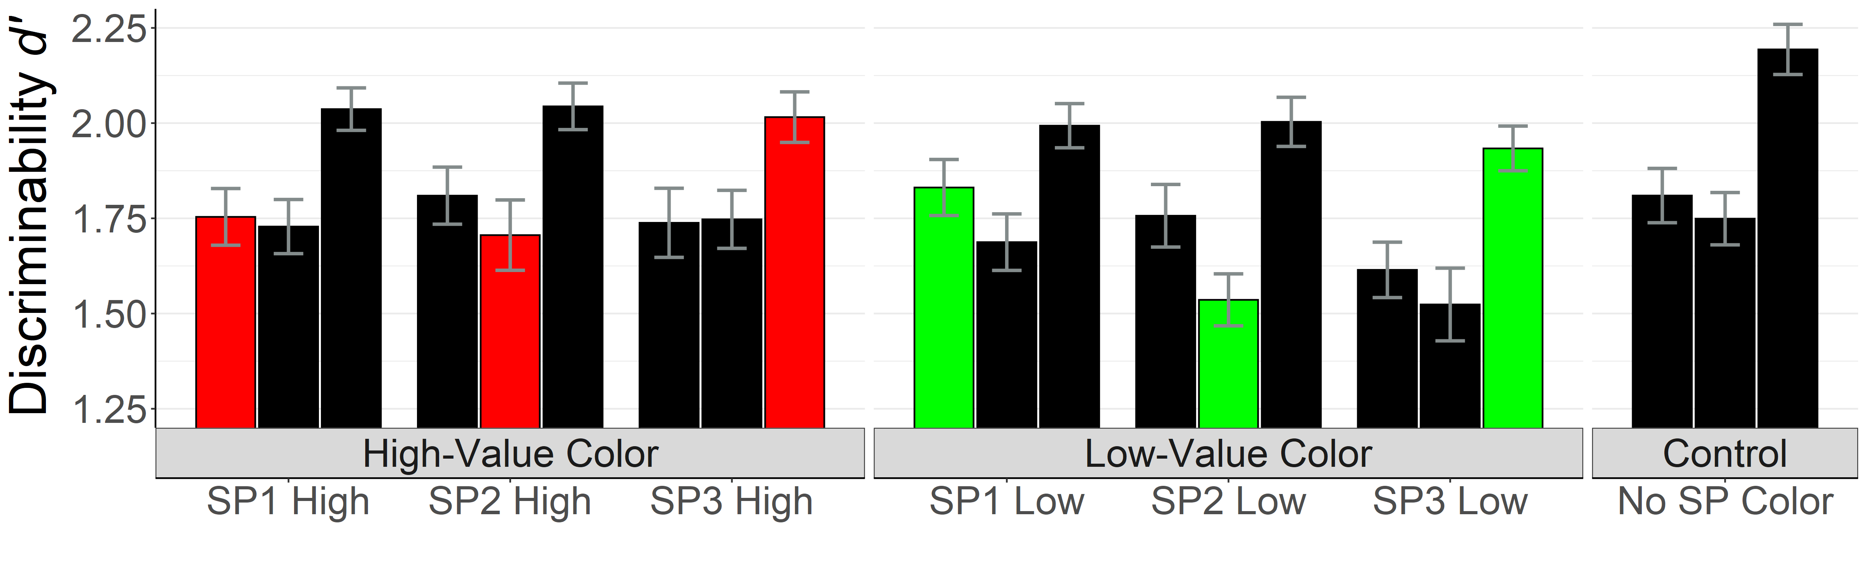
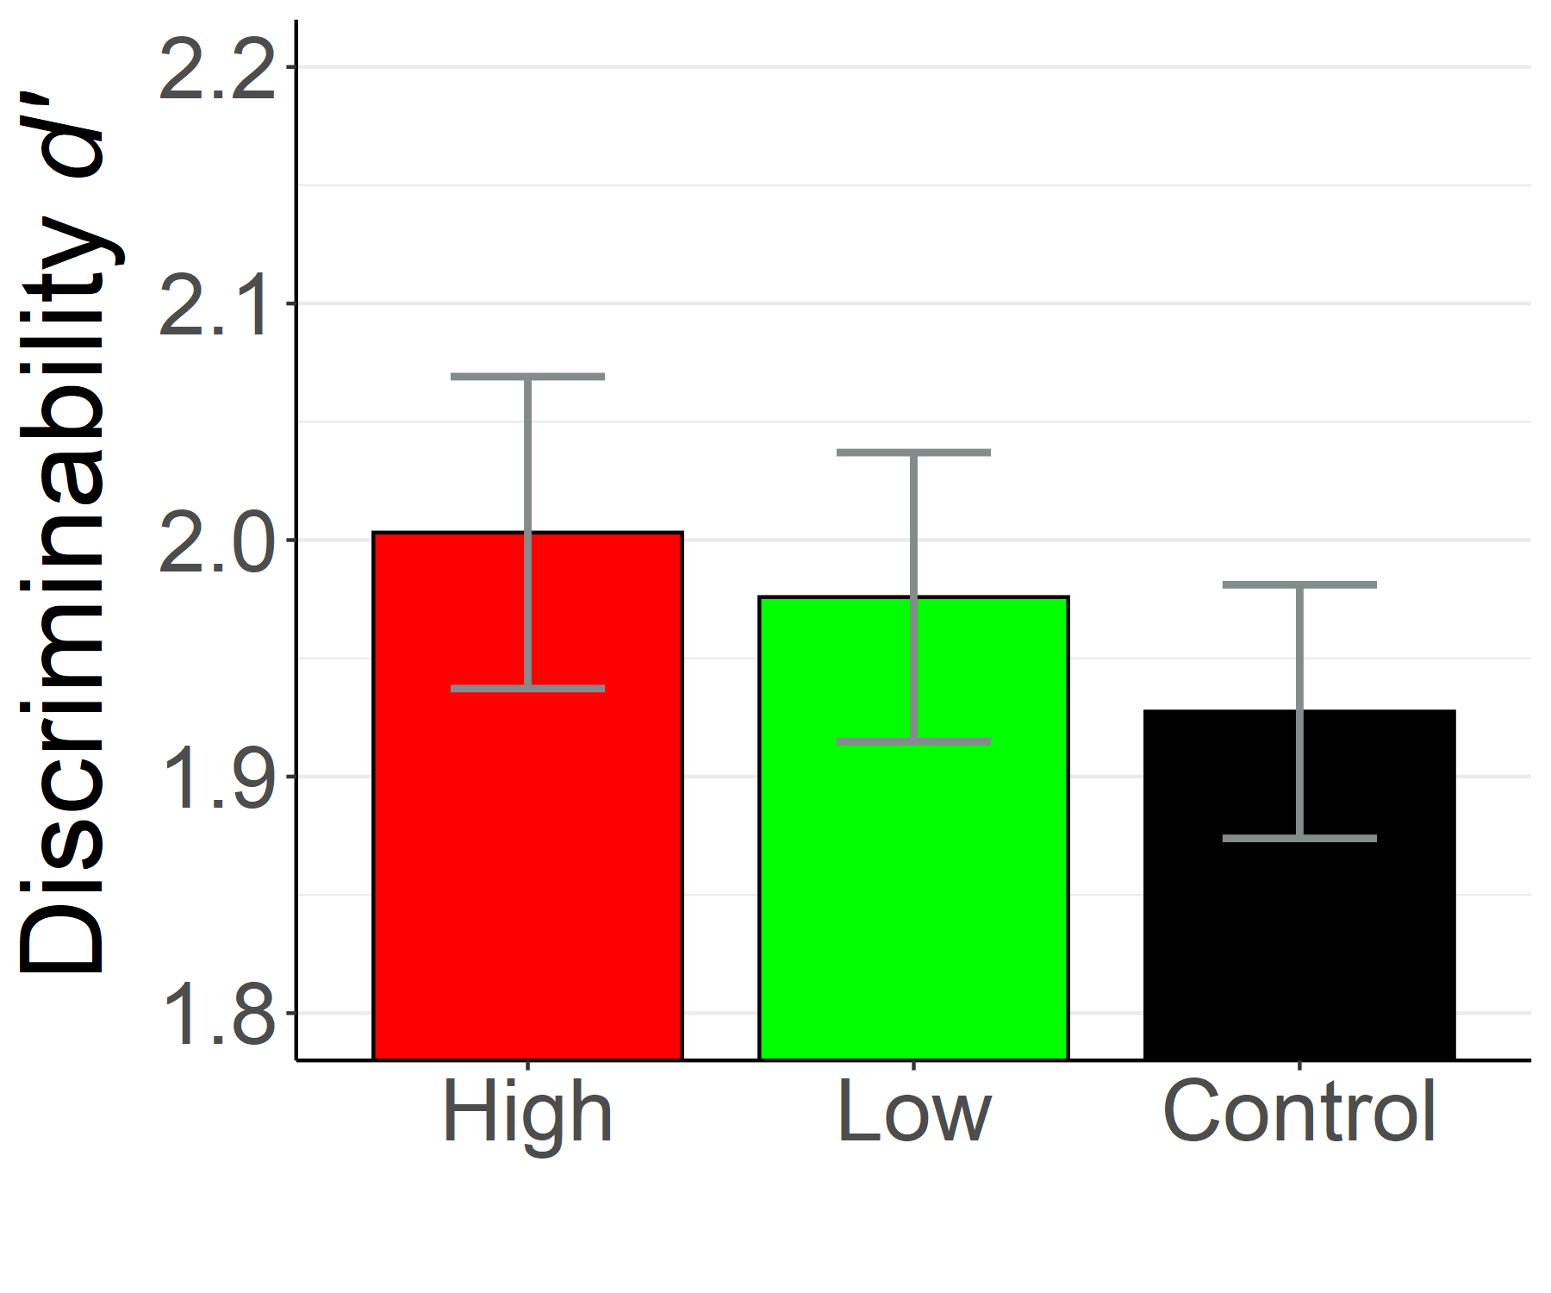
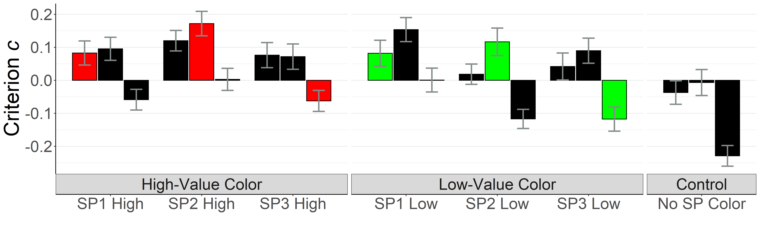
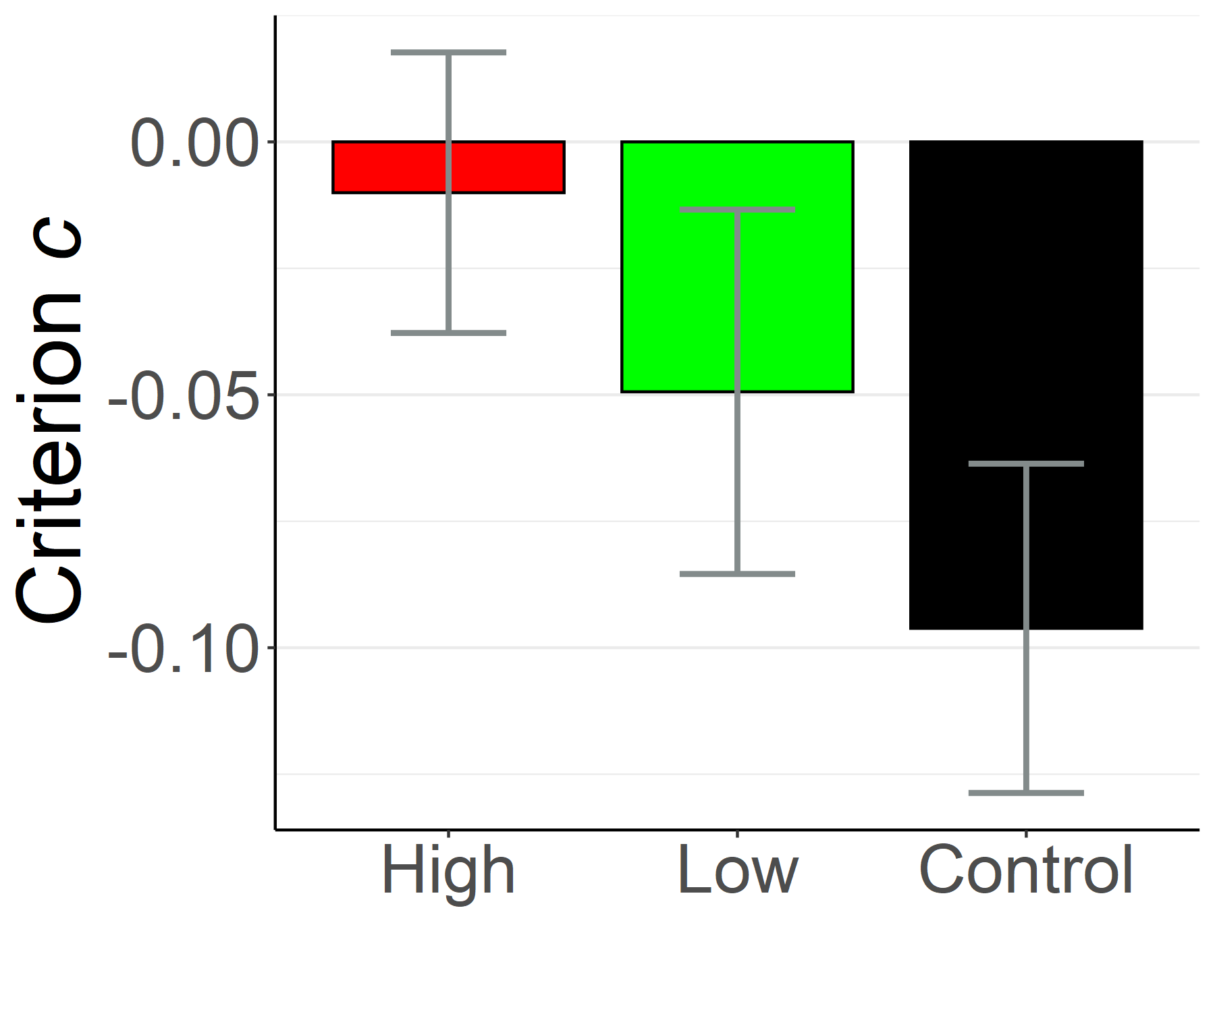
Long-Term Effects of Value-Driven Attentional Capture on Memory: Reward Influences Criterion But Not Discriminability (1451)
Jonathan Yuquimpo, Aaron Benjamin
Background
Learning Phase
Recognition Task
Methods
Stimulus features previously associated with reward can automatically capture attention in contexts where those reward associations no longer apply (Anderson et al., 2011; Le Pelley et al., 2015).
Do stimulus features associated with reward in an attention task influence memory discriminability and response bias in a later short-term memory task?
S
Old or New Symbol?
62 participants were trained to associate one of two target colors (red or green) with a higher chance of receiving the greater of two reward amounts (10 points or 2 points).
In a later recognition task, participants made old/new judgments on a sequence of three symbols, one of which was sometimes rendered in a previously rewarded color.
+ 10 points
42 points total
1500 ms
D
500 ms
Target
S
500 ms (SP3)
1000 ms
500 ms (SP2)
Horizontal or
Vertical Target?
A
500 ms (SP1) SP = Serial Position
400 – 600 ms
400 – 600 ms
Recognition Task Results
by Serial Position
Recognition Task Results Aggregated by Reward
Conclusions
Memory discriminability for colored items was no different than control items.
Response bias was more conservative for high-value items, with effects apparent at position 2 (BF = 3.11), and position 3 (BF = 26.5) compared to the control.
Prior reward appears to influence response bias but not discriminability in memory for sequences.
Try a demo of the study! http://labs.psychology.illinois.edu/~jy57/demos/PsyNomDemo.html

